Slide 1
Community care needs of looked after children at the police station Dr Laura Janes, Legal Director, Howard League for Penal Reform 24 September 2019

Slide 2
Overview
The hidden case
The issues
What can be done about them
Who can help and how to make that happen
Howard League lawyers’ network…

Slide 3
The hidden cases
If the child is looked after, are there concerns about the suitability of the placement, educational provision or obvious other unmet needs?
If the child is not “looked after” but has nowhere appropriate to live and is not looked after, should social care be doing more?

Slide 4
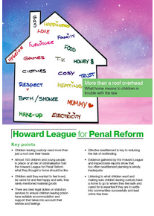
The issues: suitable accommodation
Being “looked after” means having suitable accommodation AND care
“What is meant by ‘a child who is looked after by a local authority', as defined in section 22(1) of the Children Act 1989?
…the clear intention of the legislation is that these children need more than a roof over their heads ”
Brenda Hale, R (on the application of M) (FC) (Appellant) v London Borough of Hammersmith and Fulham (Respondents) [2008] 4 All ER 271 §27

Slide 5
What is suitable accommodation?
Placements must be the most appropriate way to safeguard and promote the child’s welfare (s22(3), Children Act 1989)
Suitable accommodation is accommodation that:
so far as reasonably practicable, is suitable for the child in light of his/her needs, including his/her health needs;
in respect of which the responsible authority has satisfied itself as to the character and suitability of the provider;
complies with health and safety requirements; and
so far as reasonably practicable, taken into account the child’s
wishes and feelings; and
education, training or employment needs.
Children Act guidance, volume 2, §3.119

Slide 6
The issues: “in need” but “not looked after”
Is a child “in need” but without suitable accommodation and care?
‘in need” means the child that unless accommodated (s17, Children Act 1989):
Is unlikely to achieve or maintain, or have the opportunity of achieving or maintaining, a reasonable standard of health or development or
their health or development is likely to be significantly impaired or further impaired, or
is disabled.
Requires accommodation where (s20, Children Act 1989)
Nobody has parental responsibility; or
The child is lost or abandoned; or
The person who has been caring for him is prevented (whether or not permanently, and for whatever reason) from providing him with suitable accommodation or care
Under 16 parental consent required, 16 or 17 the child must consent

Slide 7
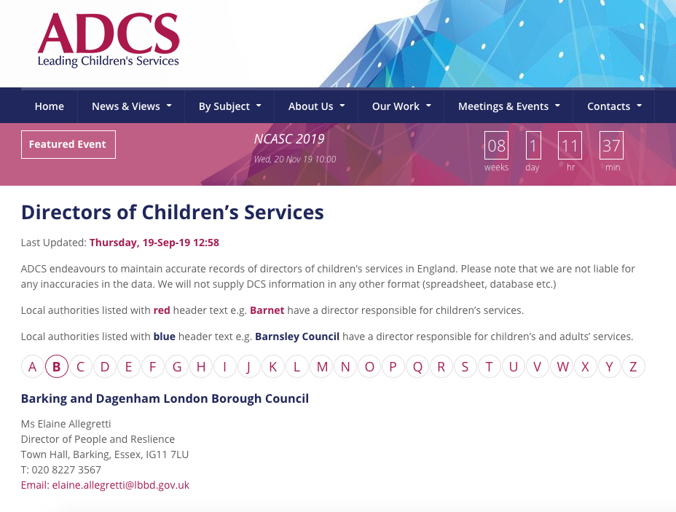
What can be done?
Write to the director for children’s services setting out concerns
Open a community care case – legal aid EXISTS, representations followed by judicial review… if necessary
https://adcs.org.uk/contacts/directors-of-childrens-services#view2

Slide 8
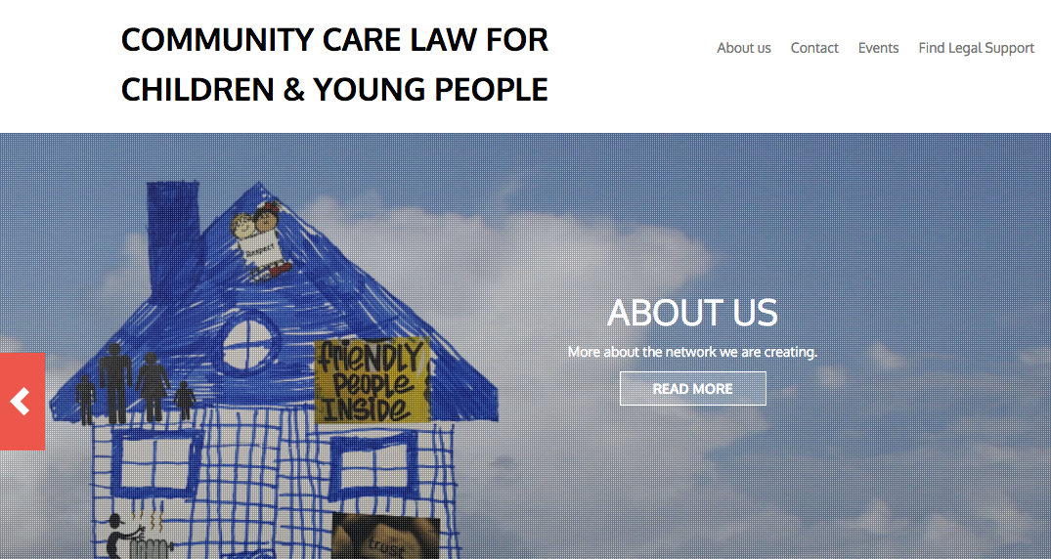
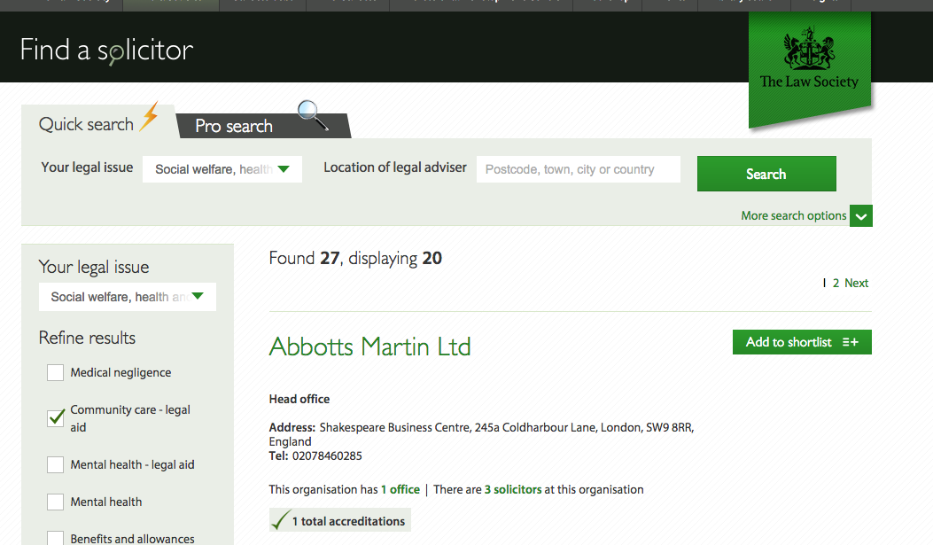
Who can help and how
If your firm has a community care contract, use it
If not, help the child find a solicitor via Law Society or CCCYP
https://cccyplaw.org.uk/
https://solicitors.lawsociety.org.uk/
https://cccyplaw.org.uk/

Slide 9
The Howard League for Penal Reform
England and Wales, since 1866
Less crime, safer communities, fewer people in prison
Policy, research, direct legal work for young people under 21 since 2002 – free helpline for young people in prison
Membership organisation - no government funding

Slide 10
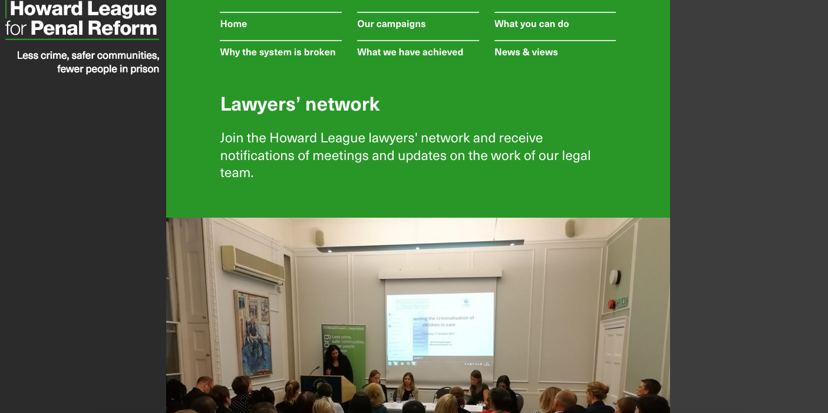
The lawyers’ network
Recent seminars have included:
Modern Slavery
Sentencing principles for young adults
Preventing the criminalization of children in care
Resettlement for children leaving prison
Child lifers
Health duties in prison
Free to sign up
https://howardleague.org/legal-work/lawyers-network/

